Slide 1
FUNCTIONS IN JAVASCRIPT
Sai Vardhan T

Slide 2
FUNCTIONS IN JS
Functions in JavaScript are reusable blocks of code that perform a specific task.
They allow you to encapsulate code, making it easier to manage, reuse, and maintain.
Here are some clear types of functions in JavaScript:
Function declaration
Function Expression
Arrow Function
Immediately invoked Function Expression (IIFE)
Named Function Expression

Slide 3
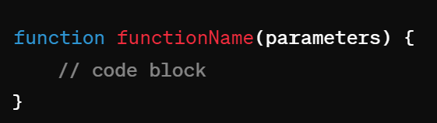
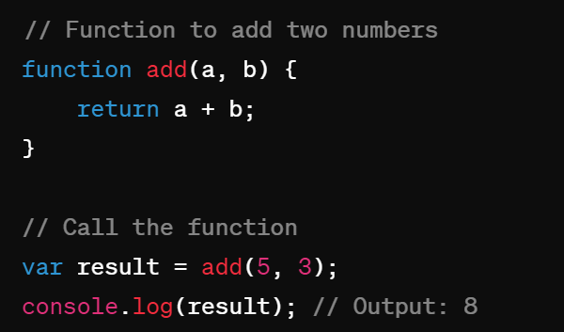
FUNCTION DECLARATION
A Function declaration defines a named function
SYNTAX:
EXAMPLE:

Slide 4
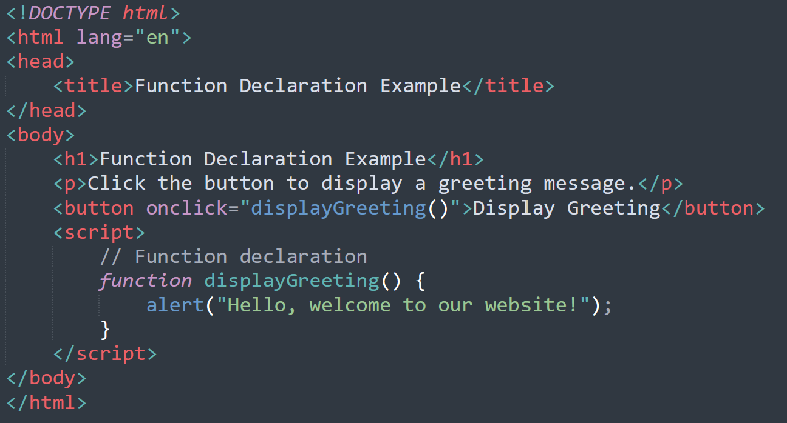
EXAMPLE

Slide 5
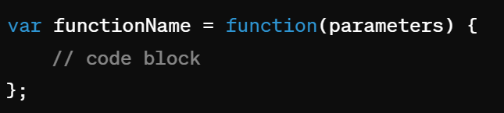
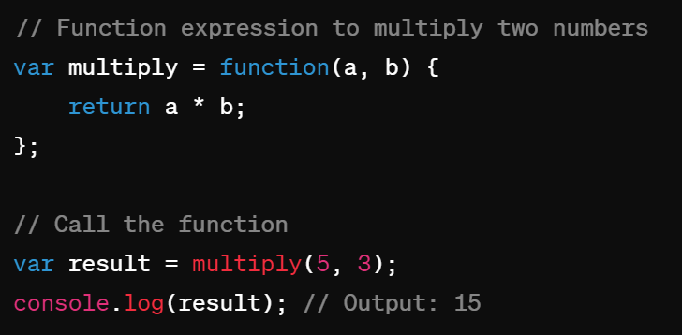
FUNCTION EXPRESSION
A Function expression defines a function as part of a larger expression
SYNTAX:
EXAMPLE:

Slide 6
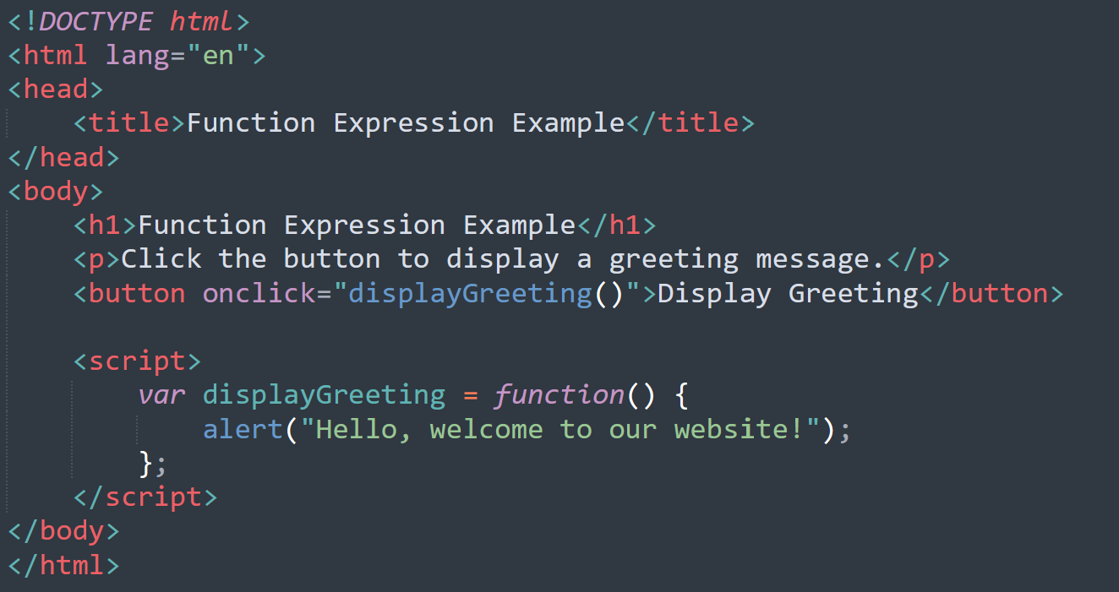
EXAMPLE

Slide 7
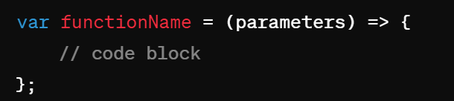
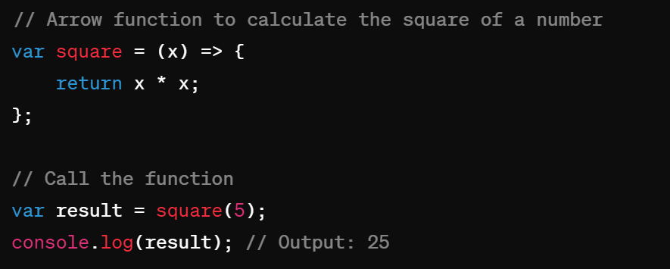
ARROW FUNCTION
EXAMPLE:
An arrow function is a concise way to write anonymous functions
SYNTAX:

Slide 8
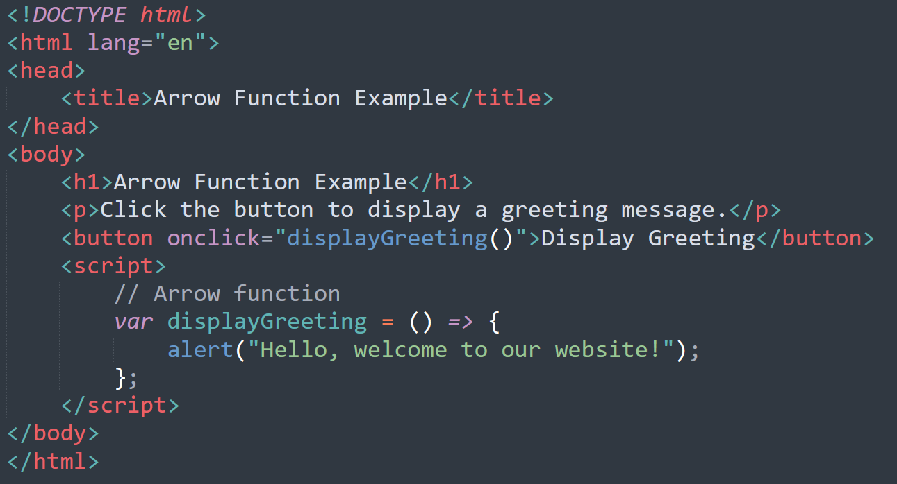
EXAMPLE

Slide 9
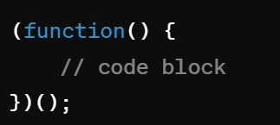
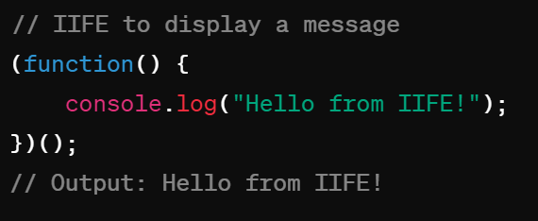
Immediately Invoked Function Expression (IIFE)
EXAMPLE:
An IIFE is a function that is executed immediately after it's defined.
SYNTAX:

Slide 10
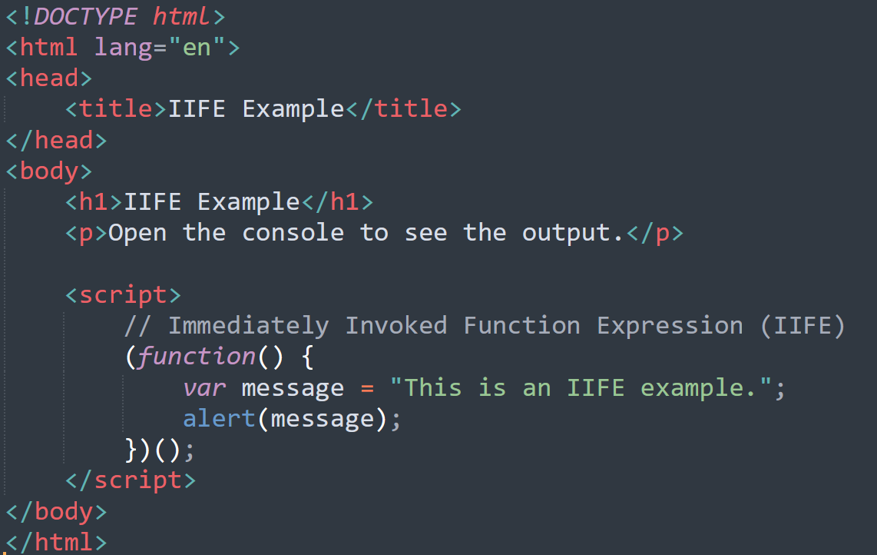
EXAMPLE

Slide 11
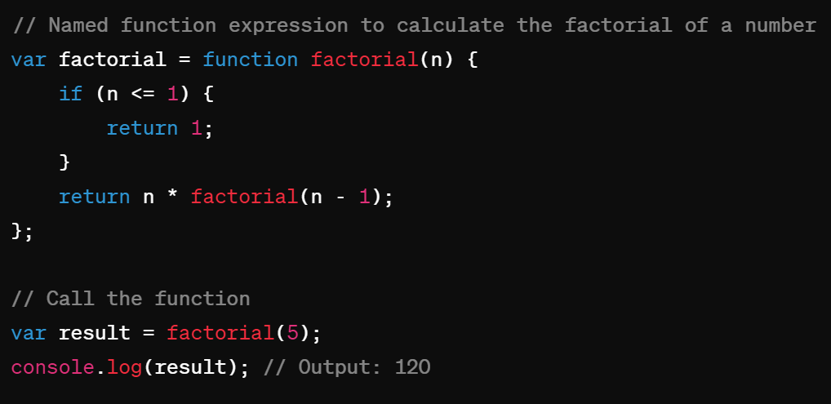
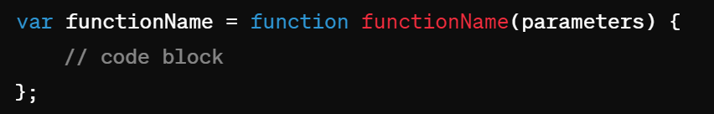
Named Function Expression
EXAMPLE:
A named function expression allows a function expression to have a name.
SYNTAX:

Slide 12
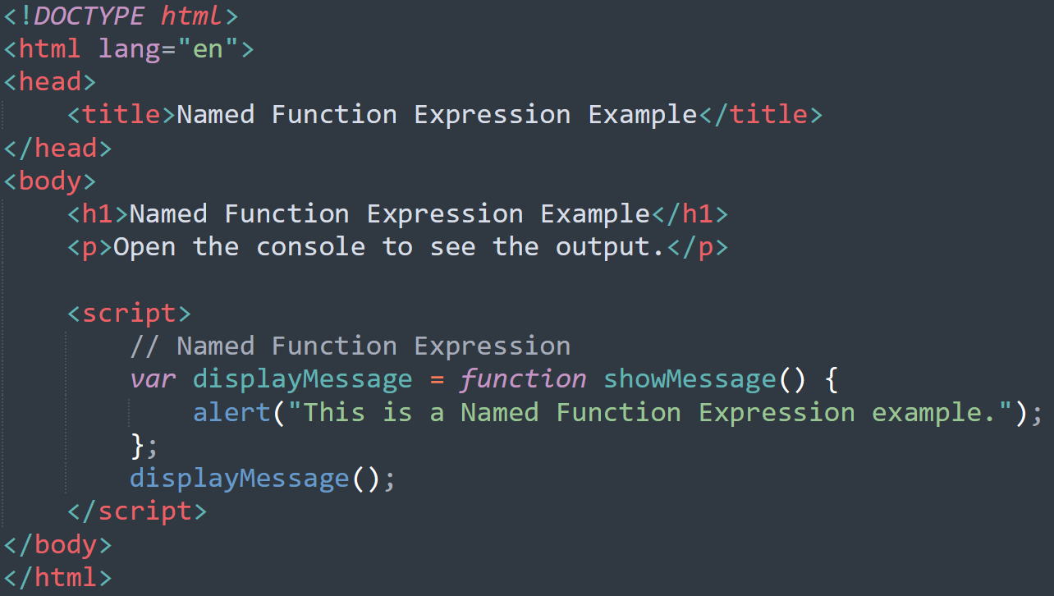
EXAMPLE

Slide 13
TYPES OF USER DEFINED FUNCTIONS
Here is the break down of functions:
With Parameters With Return type
With Parameters Without Return type
Without Parameters with Return type
Without Parameters without Return type

Slide 14
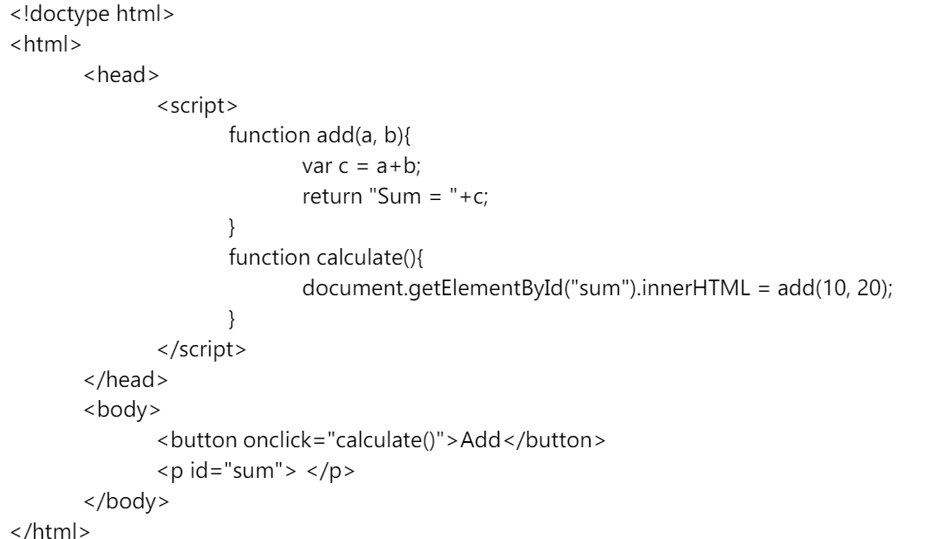
With Parameters With Return type
This type of function has parameters and return type.

Slide 15
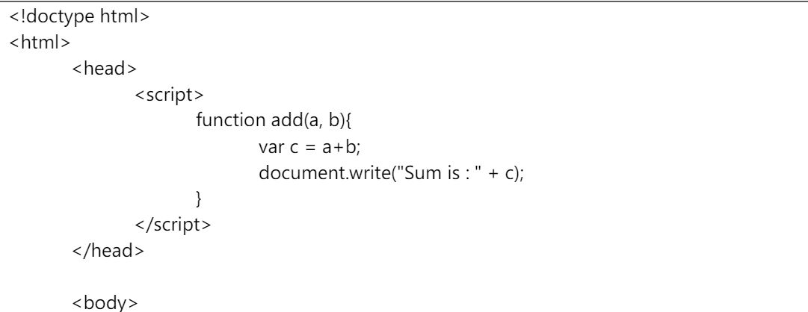
With Parameters Without Return type
This type of function takes input, performs operations, and display results from the function itself.

Slide 16
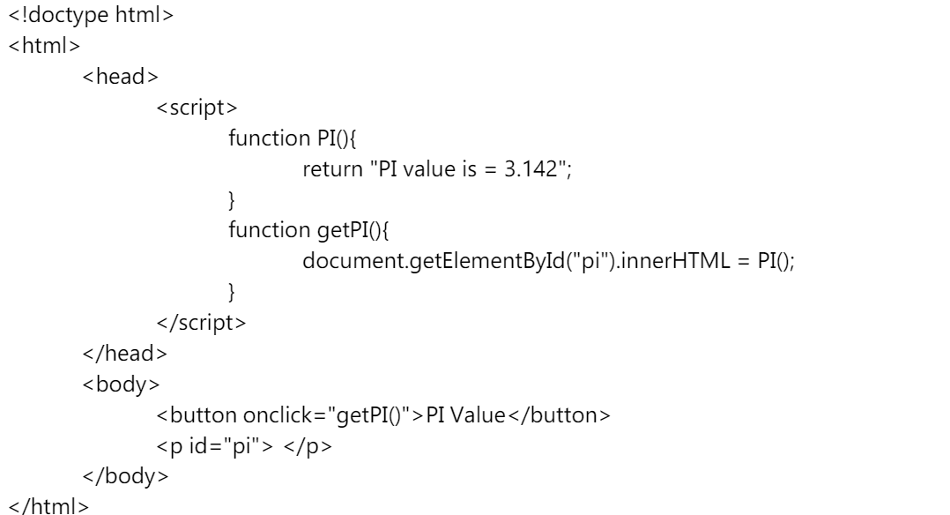
Without Parameters with Return type
This function will not have parameters but have a return type.

Slide 17
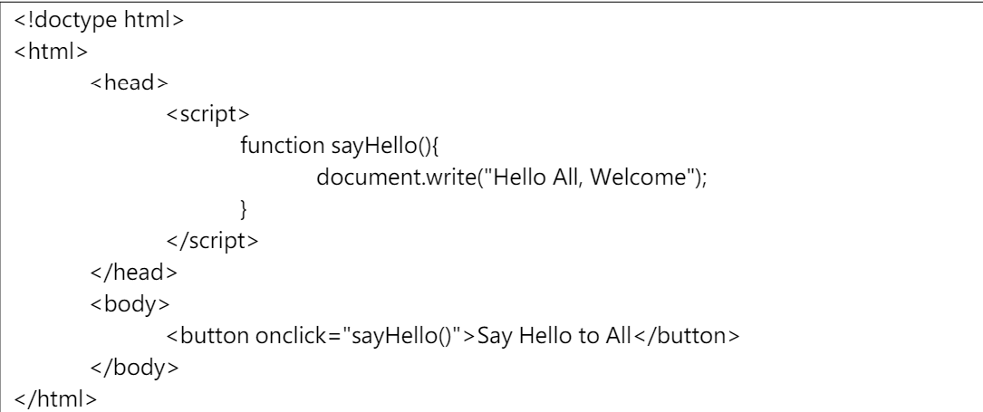
Without Parameters without Return type
This type of function is used to perform operations like clear(), removeAll(), displayAll() etc.

